Slide 1
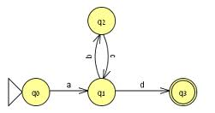
Pumping Lemma
Course Instructor: Mr. Hashim Ayub
Book: Prof. Sipser-MIT
Slides: Prof. Busch - LSU

Slide 2
The Airport System
In our new system, when an aircraft is to take off from its original airport, then at that time it requests permission to land at our airport. When it approaches the airport it is placed in a queue, and must circle the airport until a runway becomes available. Only aircraft that have permission to land are allowed to circle. The circling aircraft are landed on a first-come- first served basis.
States: permission, circling, landed

Slide 3
Non-regular languages
Regular languages

Slide 4
How can we prove that a language
is not regular?
Prove that there is no DFA or NFA or RE
that accepts
Difficulty: this is not easy to prove
(since there is an infinite number of them)
Solution: use the Pumping Lemma !!!

Slide 5
Poetry The Pumping Lemma
Any regular language L has a magic number p
And any long-enough word in L has the following property:
Amongst its first p symbols is a segment you can find
Whose repetition or omission leaves x amongst its kind.
So if you find a language L which fails this acid test,
And some long word you pump becomes distinct from all the
rest,
By contradiction you have shown that language L is not
A regular guy, resiliant to the damage you have wrought.
But if, upon the other hand, x stays within its L,
Then either L is regular, or else you chose not well.
For w is xyz, and y cannot be null,
And y must come before p symbols have been read in full.
As mathematical postscript, an addendum to the wise:
The basic proof we outlined here does certainly generalize.
So there is a pumping lemma for all languages context-free,
Although we do not have the same for those that are r.e.
-- Martin Cohn

Slide 6

The Pigeonhole Principle

Slide 7
pigeons
pigeonholes

Slide 8
A pigeonhole must
contain at least two pigeons

Slide 9
pigeons
...........
pigeonholes
...........

Slide 10
The Pigeonhole Principle
pigeons
pigeonholes
There is a pigeonhole
with at least 2 pigeons
...........

Slide 11
The Pigeonhole Principle and DFAs

Slide 12
Consider a DFA with states

Slide 13
Consider the walk of a “long’’ string:
(length at least 4)
A state is repeated in the walk of

Slide 14
The state is repeated as a result of
the pigeonhole principle
Walk of
Pigeons:
(walk states)
Are more than
Nests:
(Automaton states)
Repeated
state
Repeated
state

Slide 15
Consider the walk of a “long’’ string:
(length at least 4)
Due to the pigeonhole principle:
A state is repeated in the walk of

Slide 16
The state is repeated as a result of
the pigeonhole principle:
Walk of
Pigeons:
(walk states)
Are more than
Nests:
(Automaton states)
Automaton States
Repeated
state

Slide 17
In General:
If ,
by the pigeonhole principle,
a state is repeated in the walk
Walk of
....
....
....
Arbitrary DFA
......
......
Repeated state

Slide 18
Number of states in walk is at least
Walk of
Pigeons:
(walk states)
....
....
....
Are
more
than
....
....
Nests:
(Automaton states)
A state is
repeated

Slide 19
The Pumping Lemma

Slide 20
Pumping Lemma is used to prove that a language is NOT REGULAR.
It cannot be used to prove that a language is REGULAR.

Slide 21
Take an infinite regular language
(contains an infinite number of strings)
There exists a DFA that accepts
states

Slide 22
Take string with
(number of
states of DFA)
then, at least one state is repeated
in the walk of
Walk in DFA of
......
......
Repeated state in DFA

Slide 23
There could be many states repeated
Take to be the first state repeated
One dimensional projection of walk :
First
occurrence
Second
occurrence
....
....
....
Unique states

Slide 24
We can write
One dimensional projection of walk :
First
occurrence
Second
occurrence
....
....
....

Slide 25
In DFA:
Where corresponds to substring
between first and second occurrence of
...
...
...
...

Slide 26
Observation:
length
number
of states
of DFA
...
Because of
unique states in
...
Since, in no
state is repeated
(except q)

Slide 27
Observation:
length
Since there is at least one transition in loop
...

Slide 28
We do not care about the form of string
may actually overlap with the paths of and
...
...

Slide 29
Additional string:
The string
is accepted
Do not follow loop
...
...
...
...

Slide 30
Additional string:
The string
is accepted
Follow loop
2 times
...
...
...
...

Slide 31
Additional string:
The string
is accepted
Follow loop
3 times
...
...
...
...

Slide 32
In General:
The string
is accepted
Follow loop
times
...
...
...
...

Slide 33
Therefore:
Language accepted by the DFA
...
...
...
...

Slide 34
In other words, we described:
The Pumping Lemma !!!

Slide 35
The Pumping Lemma:
Given a infinite regular language
there exists an integer
(critical length)
for any string with length
we can write
with and
such that:

Slide 36
In the book:
Critical length = Pumping length

Slide 37
Applications of the Pumping Lemma

Slide 38
Observation:
Every language of finite size has to be regular
(we can easily construct an NFA
that accepts every string in the language)
Therefore, every non-regular language
has to be of infinite size
(contains an infinite number of strings)

Slide 39
Suppose you want to prove that
αn infinite language is not regular
1. Assume the opposite: is regular
2. The pumping lemma should hold for
3. Use the pumping lemma to obtain a
contradiction
4. Therefore, is not regular

Slide 40
Explanation of Step 3: How to get a contradiction
1. Let be the critical length for
2. Choose a particular string which satisfies
the length condition
3. Write
4. Show that
for some
5. This gives a contradiction, since from
pumping lemma

Slide 41
Note:
It suffices to show that
only one string
gives a contradiction
You don’t need to obtain
contradiction for every

Slide 42
Example of Pumping Lemma application
Theorem:
The language
is not regular
Proof:
Use the Pumping Lemma

Slide 43
Assume for contradiction
that is a regular language
Since is infinite
we can apply the Pumping Lemma

Slide 44
Let be the critical length for
Pick a string such that:
and length
We pick

Slide 45
From the Pumping Lemma:
we can write
with lengths
Thus:

Slide 46
From the Pumping Lemma:
Thus:

Slide 47
From the Pumping Lemma:
Thus:

Slide 48
BUT:
CONTRADICTION!!!

Slide 49
Therefore:
Our assumption that
is a regular language is not true
Conclusion:
is not a regular language
END OF PROOF

Slide 50
Non-regular language
Regular languages

Slide 51
Practice
Solve questions 1.29, 1.30 & 1.55 from the Sipser’s book

Slide 52
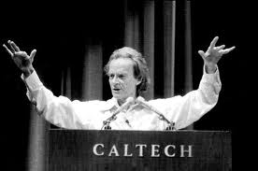
Interesting Note
In 1982, the Nobel prize-winning physicist Richard Feynman thought up the idea of a 'quantum computer',
a computer that uses the effects of quantum mechanics for computation model
Michael Sipser et al., with the deep understanding of Theory of Computation proposed Adiabatic quantum computation
Thanks

Slide 53
Practice
Examples

Slide 54
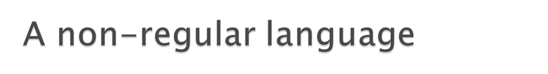
An example
L = {0^{n}1^{n}: n ≥ 0} is not regular.
We reason by contradiction:
Suppose we have managed to construct a DFA M for L
We argue something must be wrong with this DFA
In particular, M must accept some strings outside L

Slide 55
imaginary DFA for L with n states
M
x
What happens when we run M on input x = 0^{n+1}1^{n+1}?
M better accept, because x ∈ L

Slide 56
x |  | 0 | 0 | 0 | 0 | 0 ₀r₁n+1 | M
What happens when we run M on input x = 0^{n+1}1^{n+1}?
M better accept, because x ∈ L
But since M has n states, it must revisit at least one of its states while reading 0^{n+1}

Slide 57
x |  | 0 | 0 | 0 | 0 | 0 ₀r₁n+1 | M
What happens when we run M on input x = 0^{n+1}1^{n+1}?
M better accept, because x ∈ L₂
But since M has n states, it must revisit at least one of its states while reading 0^{n+1}
But then the DFA must contain a loop with 0s

Slide 58
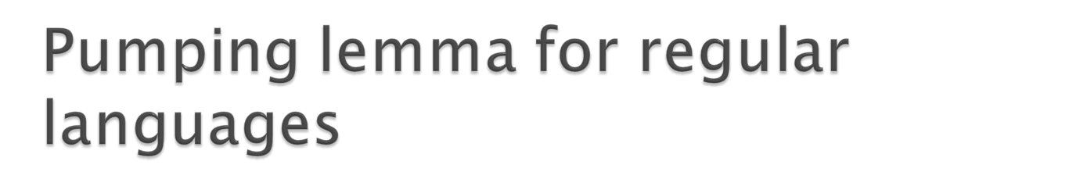
Pumping lemma: For every regular language L
There exists a number n such that for every string z in L, we can write z = u v w where
|uv| ≤ n
|v| ≥ 1
For every i ≥ 0, the string u v^{i} w is in L.
…
u
…v
w
z

Slide 59
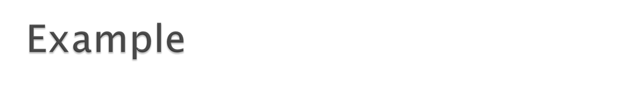
adversary
you
1 choose n
choose z ∈ L
choose i
you win if uv^{i}w ∉ L
2
write z = uvw (|uv| ≤ n,|v| ≥ 1)
L = {0^{n}1^{n}: n ≥ 0}
adversary
you
1
2
choose n
write z = uvw
000000000000000111111111111111
u v w
z = 0^{n}1^{n}
i = 2
uv²w = 0^{n+k}1^{n} ∉ L
0000000000000000000111111111111111
u v v w

Slide 60
L^{DUP} = {0^{n}10^{n}1: n ≥ 0}
adversary
you
1
2
choose n
write z = uvw
z = 0^{n}10^{n}1
i = 2
uv²w = 0^{n+k}10^{n}1 ∉ L
000000000000001000000000000001
u v w
0000000000000000001000000000000001
u v v w

Slide 61

Σ = {0, 1}
L₁ = {x: x has same number of 0s and 1s}
L₂ = {x: x = 0^{n}1^{m}, n > m }
L₃ = {x: x has same number of patterns 01 and 11} L₄ = {x: x has same number of patterns 01 and 10} L₅ = {x: x has different number of 0s and 1s}

Slide 62
L₁ = {x: x has same number of 0s and 1s}
adversary
you
choose n
write z = uvw
z = 0^{n}1^{n}
i = 2
uv²w = 0^{n+k}1^{n} ∉ L₃
000000000000000111111111111111
u v w
0000000000000000000111111111111111
u v v w

Slide 63
L₂ = {x: x = 0^{m}1^{n}, m > n ≥ 0}
adversary
you
_{z = 0}n+1₁n
i = 0
choose n
write z = uvw
uv⁰w
₌ ₀j+l₁n+1 _{∉ L2}
000000000000000111111111111111
u v w
00000000000111111111111111
u w

Slide 64

L₃ = {x: x has same number of 01s and 11s}
adversary
you
1 choose n n = 1
z = (01)^{n}(11)^{n}
z = 0111 ∉ L₄
has too many 11s
What we have in mind:
n = 1
n = 2
n = 3
z = 011
z = 010111
z = 010101111
z = (01)^{n}1^{n}
has n 01s and n 11s

Slide 65
one more 10
1
0
0
0
1
r
r
1
1
q₀
one more 01
0
0
1
1
0
0
s
s
1
L₄ = {x: x has same number of 01s and 10s}

Slide 66
L₄ = {x: x has different number of 0s than 1s}
adversary you
1 choose n z = ?
there is an easier way!
If | is regular, then | is also regular
But | is not regular, so | cannot be regular

Slide 67
L₅ = {1^{p}: p is prime}
adversary
choose n
write z = uvw = 1ª1^{b}1^{c}
you
z = 1^{p}: p > n is prime
i = ?a + c
₌ ₁a₁ib₁c
₌ ₁(a+c)+ib
₌ ₁(a+c)+(a+c)b
₌ ₁(a+c)(b+1)
₌ ₁composite _{∉ L5}
uv^{i}w
111111111111111111111111111111
u = 1ª v = 1^{b} w = 1^{c}

